Slide 1
Team 3
Final Project
Daniel Wu, Nicholas Barber-Choi, Katelyn Yu

Slide 2
Table of contents
01
02
03
04
Design Rationale
Layers
Training
Results

Slide 3
01
Design Rationale

Slide 4
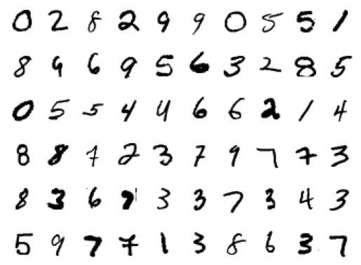
Design Rationale - Model
MNIST data set: 28x28 images of handwritten digits 0-9
Use a convolutional neural network (CNN)
Convolutional, pooling, fully connected, normalization, and dropout layers

Slide 5
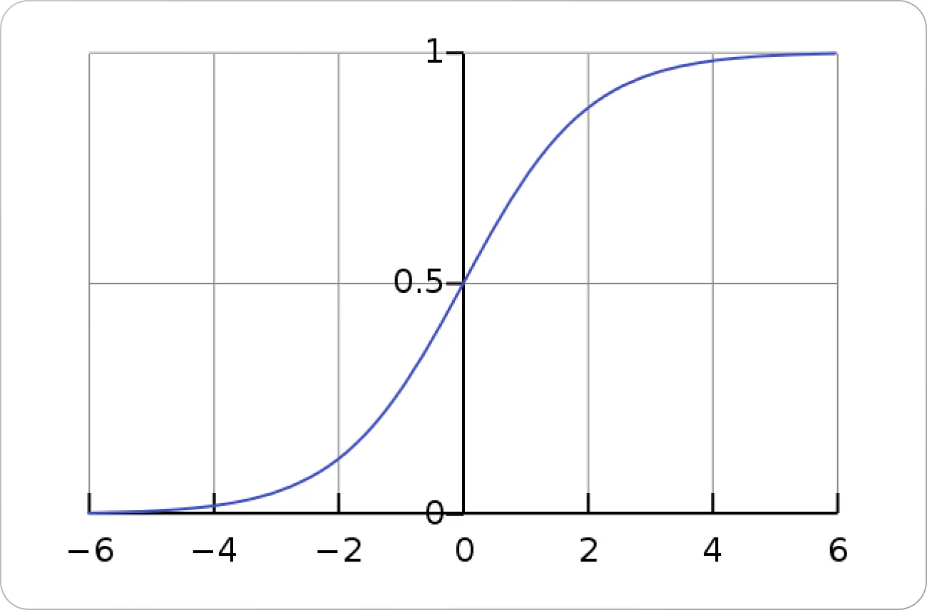
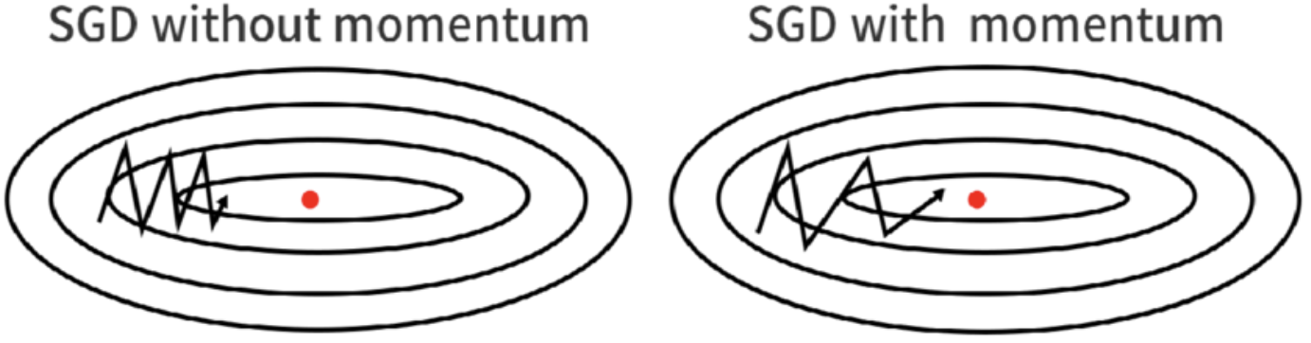
Design Rationale - Training/Evaluation
Cross Entropy Loss
Use probabilities to compare accuracy
Model fails = High Loss Model succeeds = Low loss
SGD
Handles big dataset well
Prevents overfitting
Has momentum parameter to smoothen out training

Slide 6
02
Layers

Slide 7

Layers - Convolutional Layers
Main part of a CNN
Uses filters on the image/data to extract features such as edges
Other parameters of nn.Conv2d include…
Kernel size, stride, padding
In total, used 2 convolutional layers

Slide 8

Layers - BatchNorm, Pooling Layers
BatchNorm
Normalizes all feature values are on the same scale
Allows for smoother optimization
Pooling
Reduces layer size
Used max pooling
Keeps only the most prominent features

Slide 9
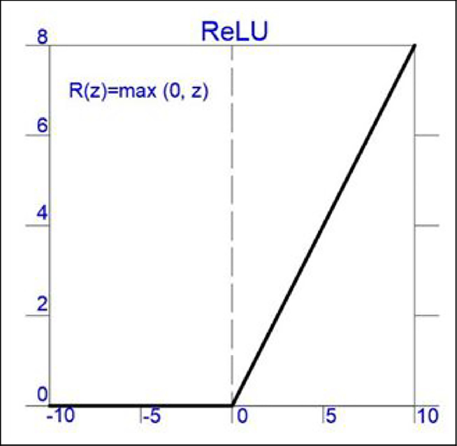
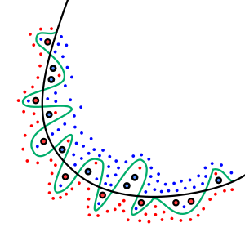
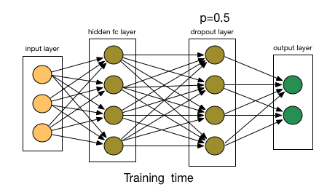
Layers - Activation, Dropout Layers
Activation
ReLU: Rectified Linear Unit
Keeps positive values, set negative to zero
Gets rid of bad input values
Dropout
Prevents overfitting

Slide 10
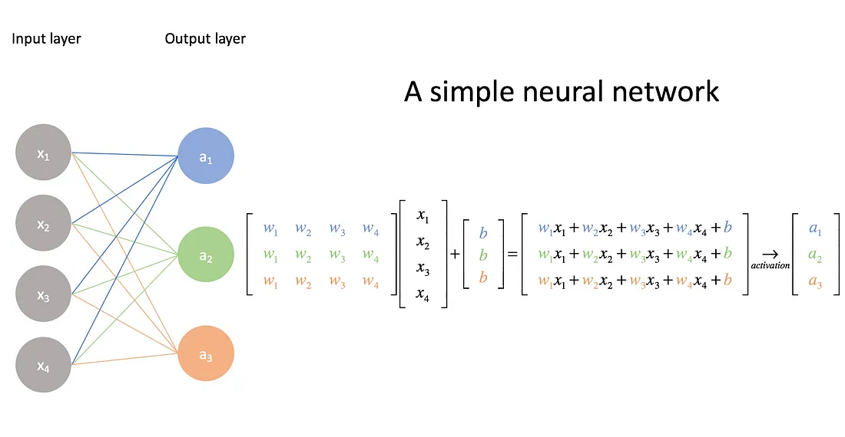
Layers - Fully Connected Layers
Every neuron in the layer is connected to the neurons in the surrounding layers through linear equations
Used here to get from 128 nodes to 10 nodes for our prediction

Slide 11
Order of Layers
Convolution
Batchnorm
ReLU
Pool
Convolution
Batchnorm
ReLU
Pool
Reshape
Fully Connected
ReLU
Dropout
Fully Connected

Slide 12
03
Training

Slide 13
Training
Hyperparameters:
Loss Function: Allows for Optimization
Epochs: How Many Times Entire Set in Run (Each Set = One or More Batches)
Batch Size: Amount of Training Data per Iteration
Learning Rate: Speed that Moves along Gradient Descent
Number of Filters (32 and 64)
Convolutional Kernel Size (Size of Filter) (3x3)
Pooling Kernel Size (Size of Compression) (2x2)
Drop Out Rate: Randomly Drops Neurons to Prevent Memorization (0.5)
Optimizer: Stochastic Gradient Descent
(faster descent with greater variance in path of convergence)

Slide 14
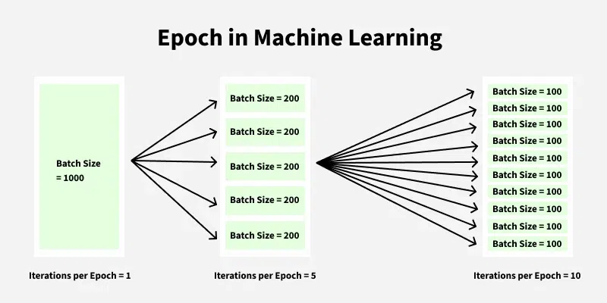
Epoch and Batch Size

Slide 15
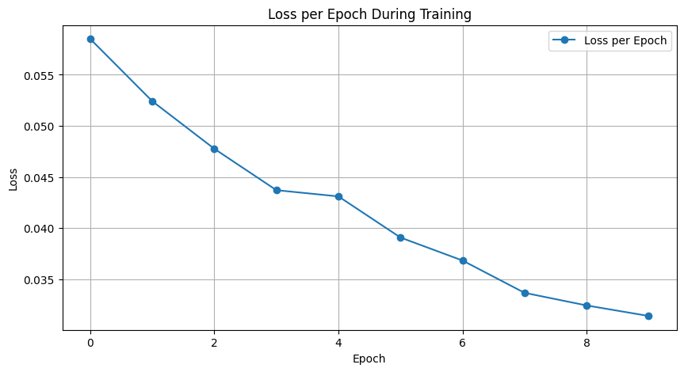
Loss Per Epoch

Slide 16
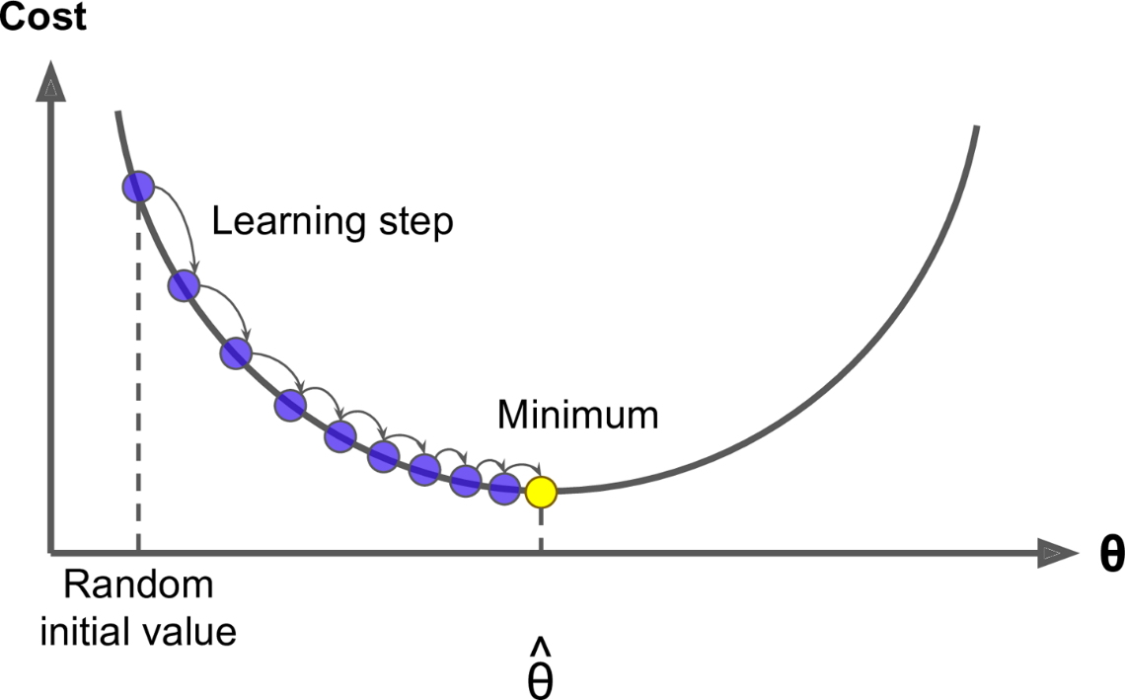
Learning Rate

Slide 17
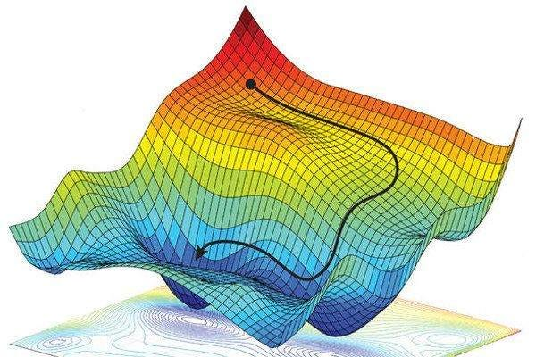
Stochastic Gradient of Descent

Slide 18
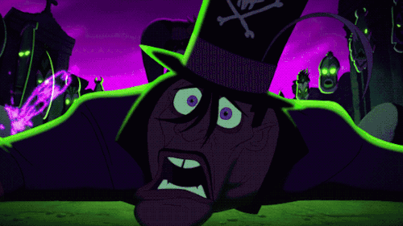
Drop Out Rate

Slide 19
04
Results

Slide 20
Results
In 11 seconds, tested 10,000 images
Total accuracy = 97.65%

